Slide 1
Topics in Data Science 2
Git Workflow

Slide 2
Agenda
Session objectives
What is version control?
<objective 1>
<objective 2>
<…>
TDS workflow

Slide 3
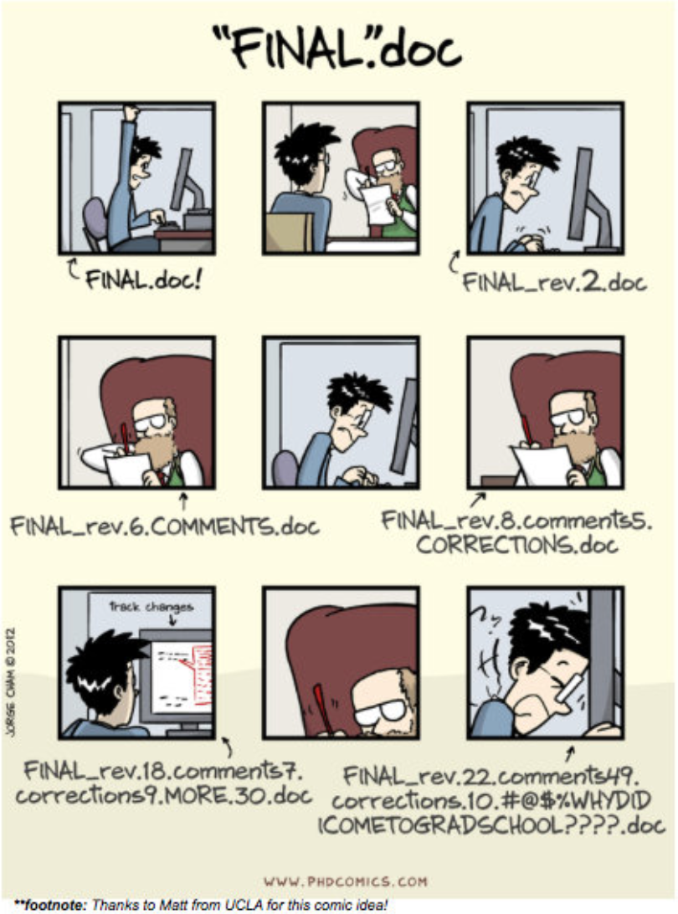
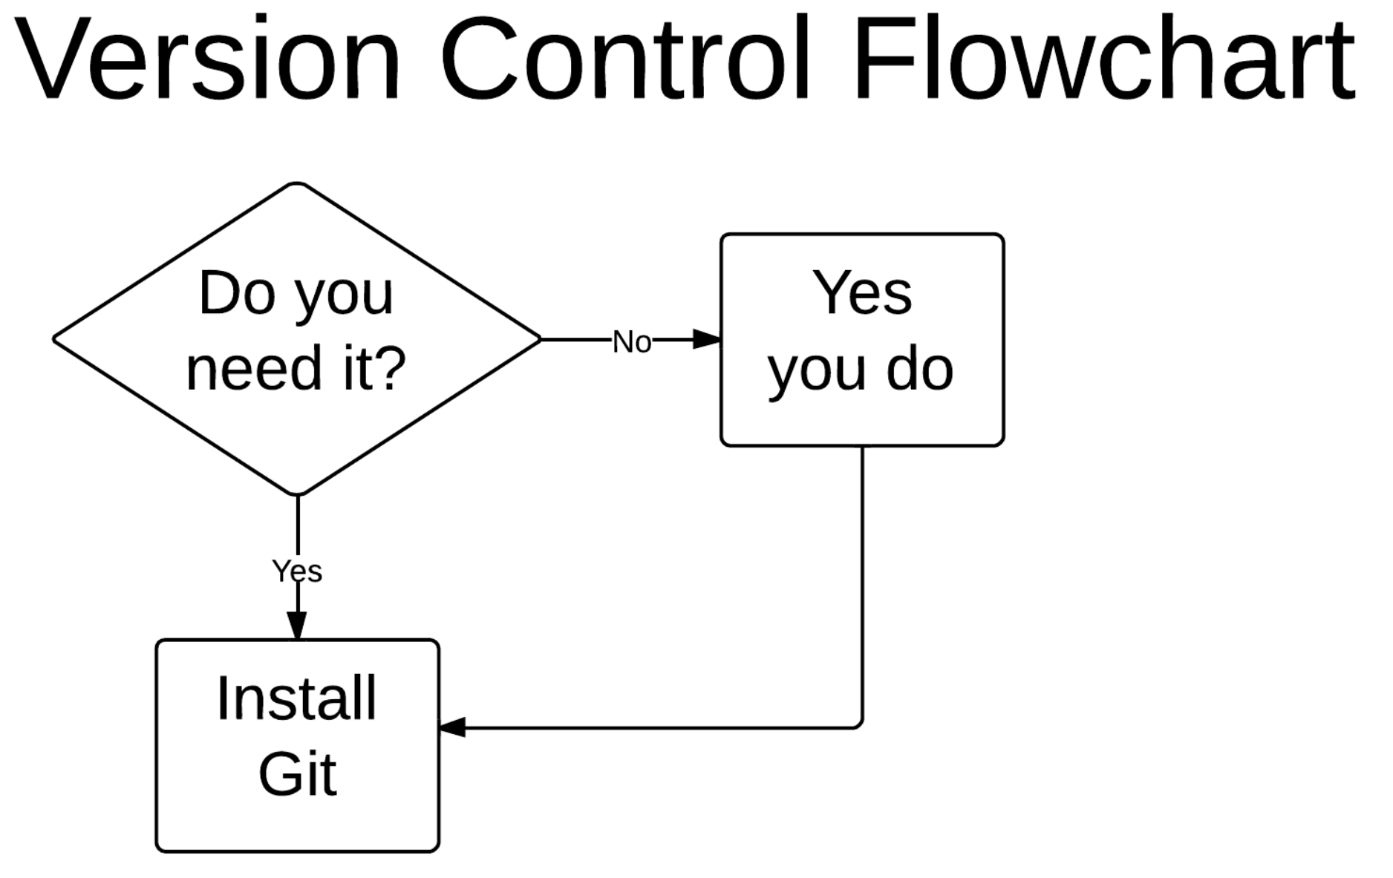
Why do we need version control?

Slide 4
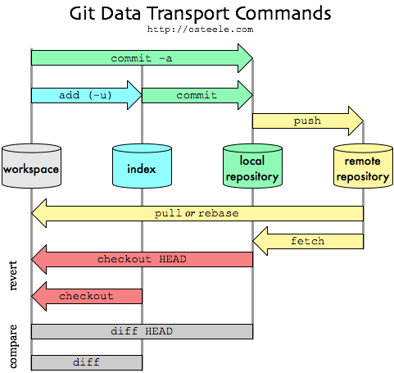
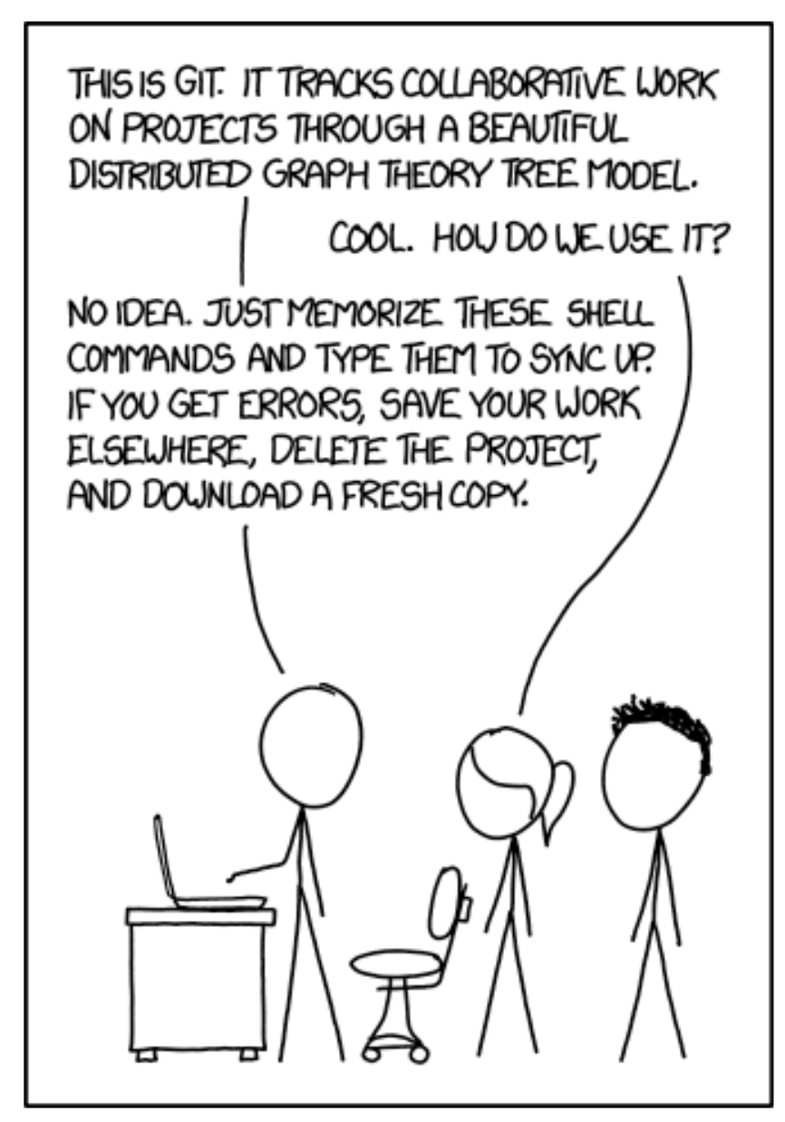
How does it work?

Slide 5
Agenda
Session objectives
What is version control?
<objective 1>
<objective 2>
<…>
TDS Workflow

Slide 6
The TDS repository
We provide a repository for our class at:
https://github.com/pds2425/course
We will use this repository to upload:
Jupyter Notebooks from the lectures
Solutions for the assignments
Interesting and helpful stuff

Slide 7
Assignment Submission Workflow
You will have to work on assignments to qualify for the (graded) capstone project
Assignments are submitted via GitHub pull requests
To work on your assignment, you have to create your own fork on GitHub:
Click on the assignment in WueCampus classroom
Login using GitHub Account
Join the GitHub classroom by clicking on your name
Accept the assignment
Wait for GitHub classroom to configure your repository and click on the link
Create a new branch named assignment_xyz

Slide 8
Assignment Submission Workflow (Google Colab)
We support assignments with Git x Google Colab
To modify and submit your assignments via Google Colab:
Click on the Google Colab link in your GitHub repository
Click on “File/Open Notebook”
Click on GitHub
Search for “pds2425”
Select your repository and Branch and open the notebook
Make changes
Click on “File/Save to github”
Select your repository and Branch and add a commit message
Create a pull request (DON’T MERGE IT)

